Slide 1
Sophomore Parent
Scheduling Night
Information Overload!

Slide 2
Agenda
  Scheduling Process & Introductions
    Schedule “requests” are due December 16th.
    Example form in slides & official form on website
    Questions: SRT, Canvas & Student Success Center
    Final Schedules due in May & require parent signature
  Curriculum Guide/HS Website
  New Courses
  Upperclassmen opportunities at BHS

Slide 3
Curriculum Guide & Website
Scheduling Policies
Diploma Types
Course Descriptions & Prereqs
http://batesvilleinschools.com/bhs/
Type Scheduling in the search bar!

Slide 4


BHS Graduate = Diploma+
(Transcript & Resume in 1)
Indiana Diploma w/Graduation Pathways
Indiana Diploma w/Honors Seal & Honors Plus Seal
- Enrollment, Employment, Enlistment
Indiana College Core
Associates Degree
Work Based Learning Credential
Career Center Certification
PLTW Certification
Business Administration Certificate
Other Employability Certifications

Slide 5
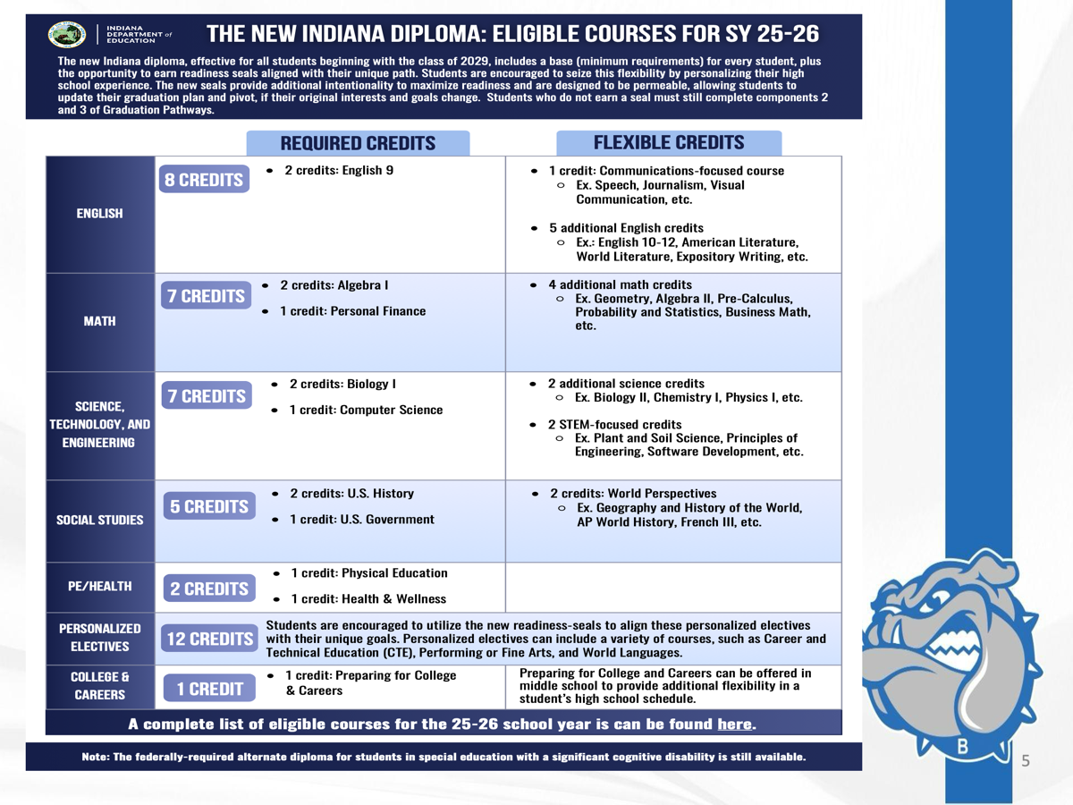

Slide 6
Graduation Pathways
Box 1 – Complete the Indiana Diploma Requirements
Box 2 – Complete a full year of Work Based Learning
Box 3 – ACT/SAT, Dual Credits, CTE Concentration

Slide 7
New Diploma/Graduation Requirements:
Four - 1 credit courses
Computing Foundations for a Digital Age (CS Credit)
(SRT Junior Year)
Communications Focused Credit
(WBL: English 12, Yearbook, COMM 101, COMM 102)
Personal Financial Responsibility
(Senior Year with Economics)
Preparing for College & Careers
(Freshman Seminar, first semester)

Slide 8
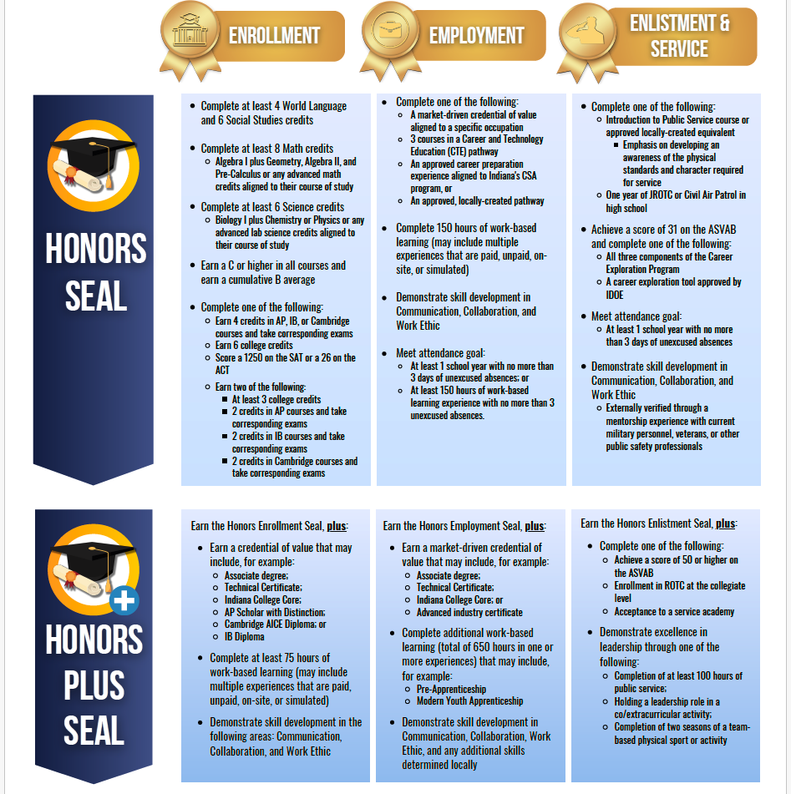

Slide 9
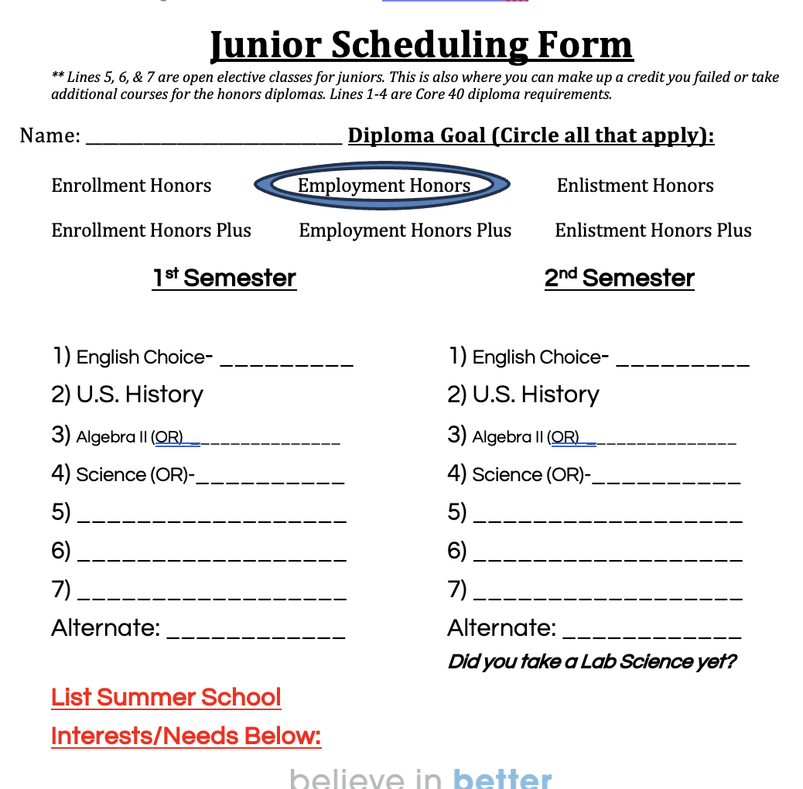

Slide 10
Analytical Algebra II
*Algebra I -> Geometry -> Algebra II -> Pre-Cal
(or Finite) -> Calculus
*Algebra I -> Geometry -> Analytical Alg. II
Designed for students who have had a difficult time passing or doing well in Algebra I & Geometry
Less rigorous
NON-STEM interested students
Does not prepare students for Pre-Cal or Finite Math

Slide 11
Upperclassmen “new to you” course opportunities
Work Based Learning: Career Exploration Internship
(aka: Mentorship, Cadet Teaching, etc.)
Southeastern Career Center
Advanced Placement Courses
Ivy Tech Pathways: Engineering, Health Careers (CNA & CCMA) & Software Development
WBL: (MMH does require and application to be accepted and all MMH affiliated

Slide 12
More…”New to you”
NOT new to BHS, but NEW to your students:
Dual Credit and Dual Enrollment Courses
Ivy Tech Indiana College Core & “Other” Certificates
Associates Degree Planning
English choices are semester based

Slide 13
“Newer”
Course Options
Certified Clinical Medical Assistant Pathway (12)
CNA (11-12)
Software Development (11-12)
Building Trades: Carpentry to Electrical (10-12)
Welding (10-12) – See next slide
Supervised Agricultural Experiences (WBL – 12)
WBL: English 12 – Technical Communications

Slide 14
“Newer”
Course Options
BHS Innovation Center
Reserve your SPOT by contacting
Mrs. Burck ASAP via Canvas
Welding @ BHS
- Open to grades 10 - 12
- Replaces the Career Center Welding Program
- Spacing limited
- Will take TWO Blocks Per Semester
- Two year program
- Dual Credit through Ivy Tech
- Certification & certificates eligible

Slide 15
Newer Course
BHS Innovation Center
Reserve your SPOT by contacting
Mrs. Burck ASAP via Canvas
Building Trades @ BHS
- Open to grades 10 - 12
- Replaces the Career Center Building Trades Program
- Spacing limited
- Will take TWO Blocks Per Semester
- Two year program
- Potential for certification & certificates (NCCER)

Slide 16
** NEW **
Course Options
Medical Terminology & Principles of Healthcare
- Available for Sophomore entry!
PLTW: Principles of Computing (Year 1)
PLTW: Topics in Computer Science (Year 2)
Graphic Design & Layout (Year 3)
Military Exploration (6am to 7:30am)
Yearbook: Counts as up to 2 Language Arts Credits (Example: English 9 (2), English 10 (2), Communications (1), Creative Writing (1), Composition (1), Yearbook (1)

Slide 17
AP Courses & Exams
AP Statistics (MATH 200)
AP Chemistry (CHEM 101)
AP Spanish (SPAN 201 & 202)
AP exam fees are covered by BHS
Students must score at least a 3 or higher on their exam to earn college credit

Slide 18
Southeastern
Career Center
Auto Service
Aviation
Building Trades
Computer Aided Drafting
Computer Repair
Criminal Justice
Digital Media
Cosmetology
Culinary Arts
Dental Career
Diesel
Electrical Trades
Fire Safety/Emergency Services
Health Science
Heavy Equipment
Law Enforcement
Logistics, CDL
Medical Technology
Precision Machine
Industrial Maintenance

Slide 19
Work Based Learning
Career Exploration Internship – Career Exploration through local businesses of the student’s choice. (Mentorship)
Career Exploration Internship – students explore the field of education through their choice of grade level or subject area.
(Cadet Teaching)
Full Year Experience Required for All WBL experiences

Slide 20
WBL Sample Schedule
Sample
student has any form of WBL
Block B1
Monday | Tuesday | Wednesday | Thursday | Friday
B1: Class Professional Development | B1: Site Experience | Regular Schedule | B1: Site Experience | Regular Schedule

Slide 21
SENIOR ONly Scheduling Options
Work Based Learning & English 12
Students in the graduating class of 2028 at Batesville High School who have shown competency by earning six dual credits for the Enrollment Seal, completing or enrolling in a three-course CTE sequence for the Employment Seal, completion or enrollment in the Introduction to Public Service course and plan to take the ASVAB for the Enlistment Seal, or are on track to complete a Certificate (CT) or Technical Certificate (TC) are eligible to earn one credit in English and one credit in Technical communications through WBL. These credits will be earned through a full year of classroom instruction in either Work-Based Learning or Career Exploration Internship. Students will receive credit for both their work experience and English. This is a required, full-year, two-semester program. Maximum of one English credit can be earned through WBL.
Course Titles:
WBL: ENG 12 – Technical Communications
CEI: ENG 12 – Technical Communications
Notes:
Skip slide for current freshman

Slide 22
Dual Credit & Dual Enrollment
How many dual credits are awarded for each Ivy Tech class?
How will students be transported to and from Ivy Tech classes
Does Ivy Tech follow the same academic calendar as BHS?

Slide 23
DC and DE continued…
If BHS is not in session, but Ivy Tech is, then you are expected to attend your Ivy Tech class if at all possible. (Weather permitting)
BHS dual credit and dual enrollment students do NOT have the ability to withdraw from a grade they earned in an Ivy Tech course. (Such as a regular college student might have the ability.
A grade of a D or higher in an Ivy Tech course will be awarded dual credit from Ivy Tech, but will not be transferable to other colleges.
Notes:
Joe Speaks here

Slide 24

Ivy Tech
Scheduling Information
Sammie Hardebeck
Director of K-14 Initiatives
C. Janelle Stenger
College Connection Coach &
High School Advisor

Slide 25
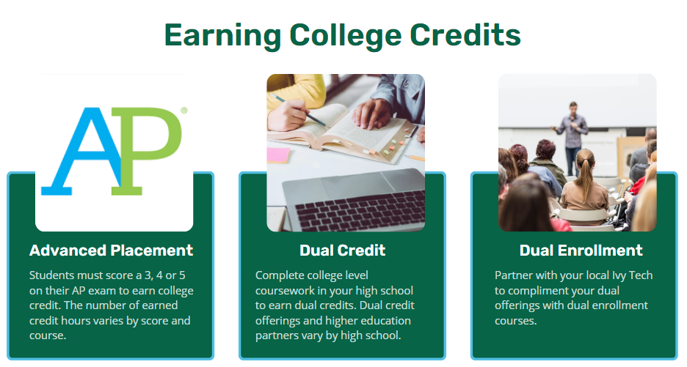

Slide 26
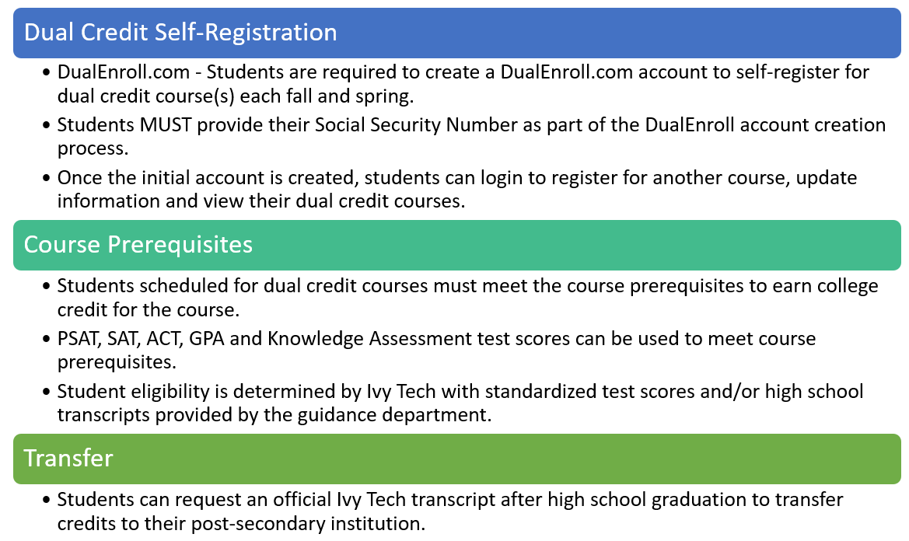
Dual Credit/Enrollment Admission Process

Slide 27
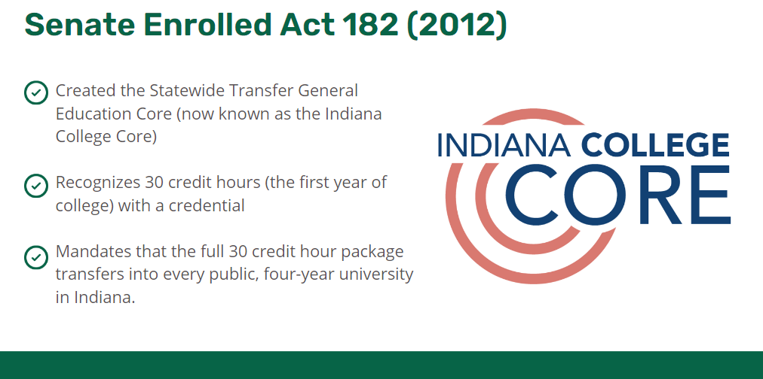

Slide 28
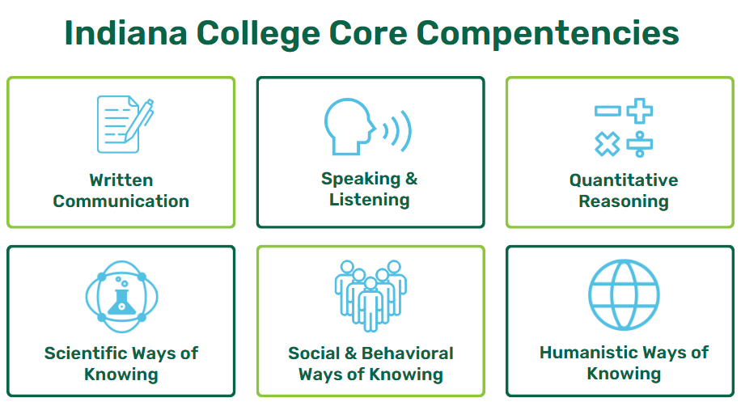

Slide 29
Indiana College Core
Written/Speaking: 6 credits in this area
Composition - ENGL 111 (3 credits)
Speech - COMM 101 (3 credits)
Rhetoric & Argument - ENGL 215 (3 credits)
Interp. Communications – COMM 102 (3 credits)
Math: 3-9 credits in this area
Finite - MATH 135 (3 credits)
Pre-Calculus - MATH 136 (3 credits)
Pre-Calculus - MATH 137 (3 credits)
Calculus - MATH 211 (4 credits)
AP Statistics *
Science 3-10 credit in this area
Physical Science - SCIN 111 (3 credits)
Earth Science - SCIN 100 (4 credits)
Biology - BIOL 101 (3 credits)
AP Chemistry *
Social/Behavioral 3-9 credits in this area
Psychology - PSYC 101 (3 credits)
Abnormal Psychology - PSYC 205 (3 credits)
Humanistic/Art 3-9 credits in this area
Literature - ENGL 206 (3 credits)
Philosophy - PHIL 101 (3 credits)
Ethics – PHIL 102 (3 credits)
AP Spanish *
Corresponding AP Course Transfer:
AP Chem. = CHEM 101
AP Stats = MATH 200
AP Spanish = SPAN 201 & SPAN 202
* To earn AP transfer credit, a score of 3 or higher must be earned on the AP exam. Students are responsible for sending their AP exam scores to Ivy Tech for transfer.

Slide 30
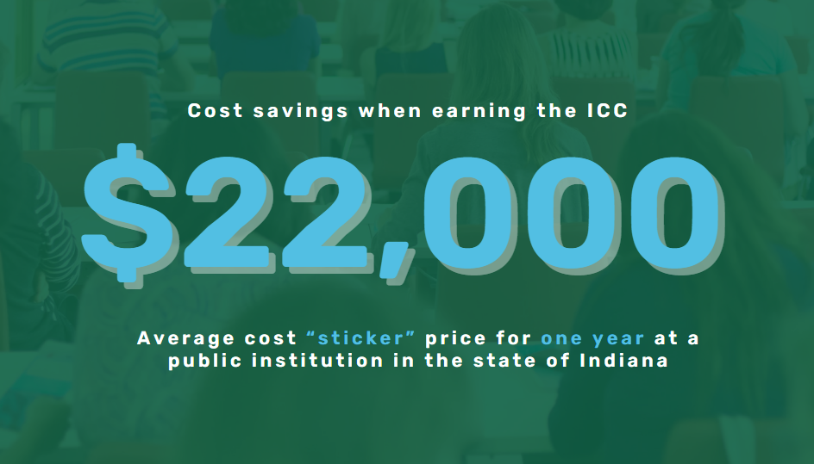

Slide 31


Slide 32
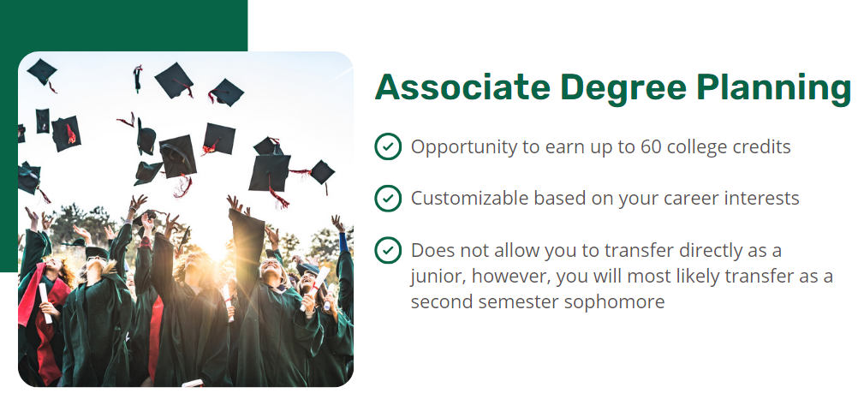

Slide 33
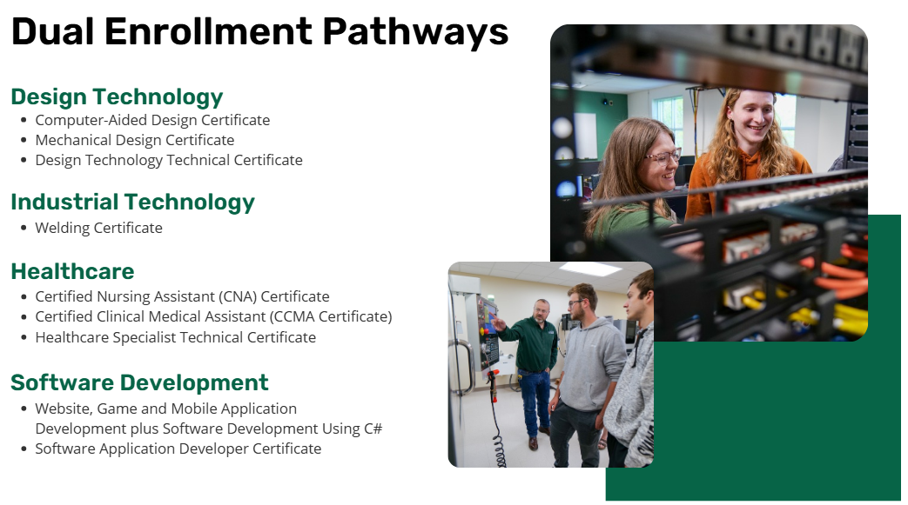

Slide 34
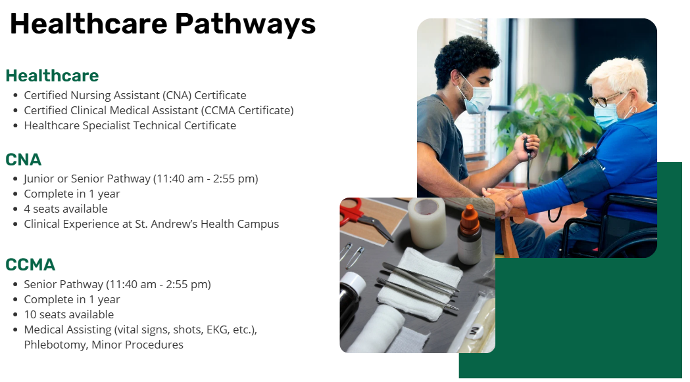

Slide 35
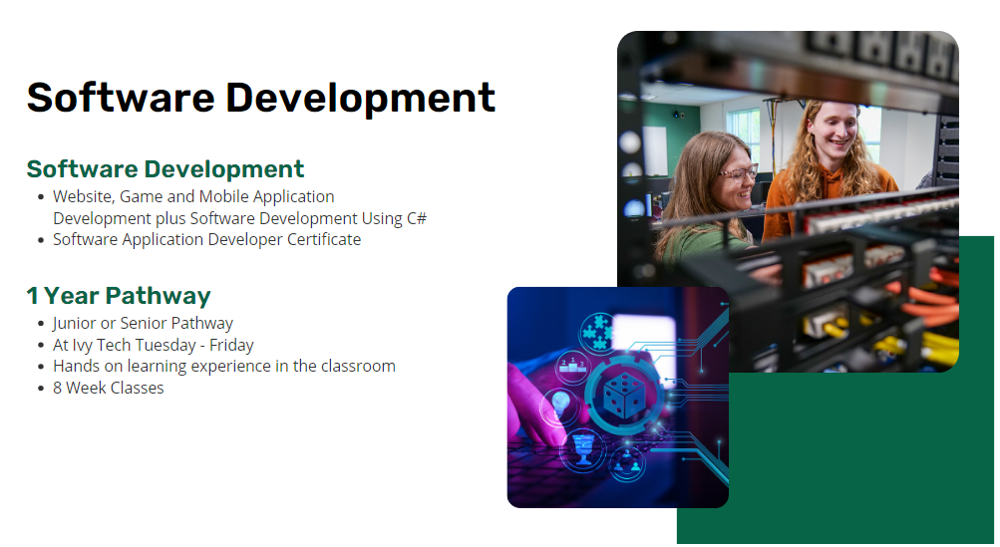

Slide 36
Ivy Tech vs. BHS Calendar: 2026-2027
BHS First Semester Dates: 8/11/26 – 12/22/26
Ivy Tech First Semester Dates: 8/25/26 - 12/21/26
BHS Second Semester Dates: 1/6/27 – 5/27/27
Ivy Tech Second Semester Dates: 1/11/27 - 5/9/27
BHS Fall Break: 10/12/26 - 10/16/26
Ivy Tech Fall Break: 10/19/26 - 10/23/26
BHS Spring Break: 03/19/27 – 03/26/27
Ivy Tech Spring Break: 3/8/27 - 3/12/27

Slide 37
Schedule “Requests”
Due
December 16th !!!
Submit to Guidance
Guidance Office Contact Information:
Arika Burck, School Counselor
aburck@batesville.k12.in.us
Jen Steinkamp, School Counselor
jsteinkamp@batesville.k12.in.us
Sammie Hardebeck, Ivy Tech K-14 Director
shardebeck3@ivytech.edu

